Slide 1
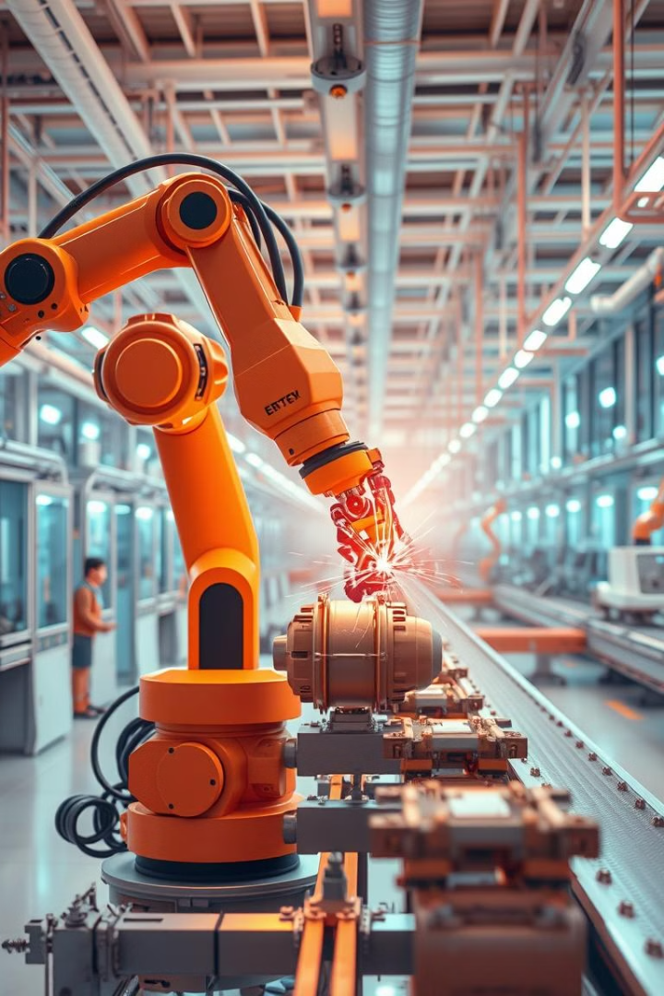
Introduction and Use Case:
Unplanned machine breakdowns can cripple manufacturing operations with huge financial losses. Predictive maintenance is proactive, using real-time data and machine learning to predict and prevent failures before they occur. In this presentation, we will explore the development of a predictive maintenance system that uses AI to optimize maintenance schedules, reduce downtime, and improve overall efficiency.

Slide 2

Predictive Maintenance for Industrial Equipment
Team Members:
Roshan Rath D24011
Sujeevana Jonna D24016
Aishik Bhattacharjee D24003
Vaibhav A D24018

Slide 3
The Data: A Window into Machine Health
Dataset Source
Key Features
Failure Indicators
The UCI Machine Learning Repository provides a valuable dataset containing real-world sensor readings from a manufacturing process.
RPM
TWF (Tool Wear Failure)
Torque
HDF (Heat Dissipation Failure)
Tool Wear
PWF (Power Failure)
OSF (Overstrain Failure)
RNF (Random Failure)

Slide 4

Data Collection and Initial Model Training
1
Exploratory Data Analysis
2
Random Forest Model
We conducted thorough exploratory data analysis to understand the relationships between features and failure events.
A Random Forest model was trained to predict machine failures based on the collected sensor data.
3
Model Artifacts
scaler.pkl (data standardization)
model.pkl (trained Random Forest)

Slide 5
Enhancing Accuracy: Synthetic & Live Data
Synthetic Data Generation
Live Data Simulation
Model Training Pipeline
Over 500 synthetic data records per batch which were generated using real dataset statistics to expand training data.
Live data was simulated to mimic real-world sensor readings with potential drift and changes.
Six machine learning models were trained and evaluated: Random Forest, XGBoost, CatBoost, Gradient Boosting, SVM, and Logistic Regression.

Slide 6
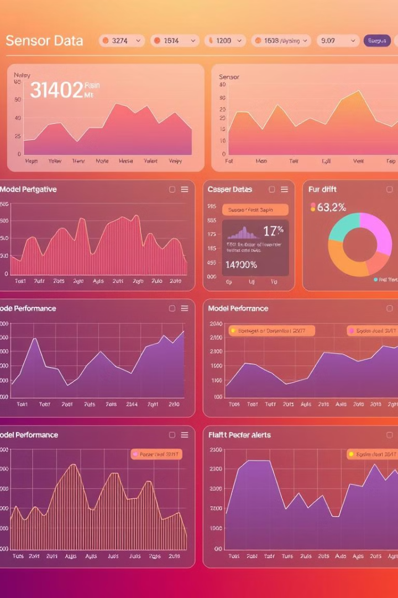



Adapting to Change: Drift Monitoring & Retraining
Drift Detection
Jensen-Shannon Divergence (JSD) was used to measure the difference between live data and original data.
Threshold for Retraining
A JSD value greater than 0.3 indicated significant drift, triggering model retraining.
Model Retraining Process
Live data was merged with original data, and the best model was retrained to adapt to changes in the data.

Slide 7
Making Predictions Accessible: Web App Deployment
Streamlit App (app.py)
FastAPI App (app1.py)
Cloud Deployment
A Streamlit web application provides a user-friendly interface for viewing predictions and accessing model insights.
A FastAPI REST API enables batch inference and integration with other systems through API calls.
Both the Streamlit and FastAPI applications were deployed on Google Cloud Run for real-time access and scalability.

Slide 8
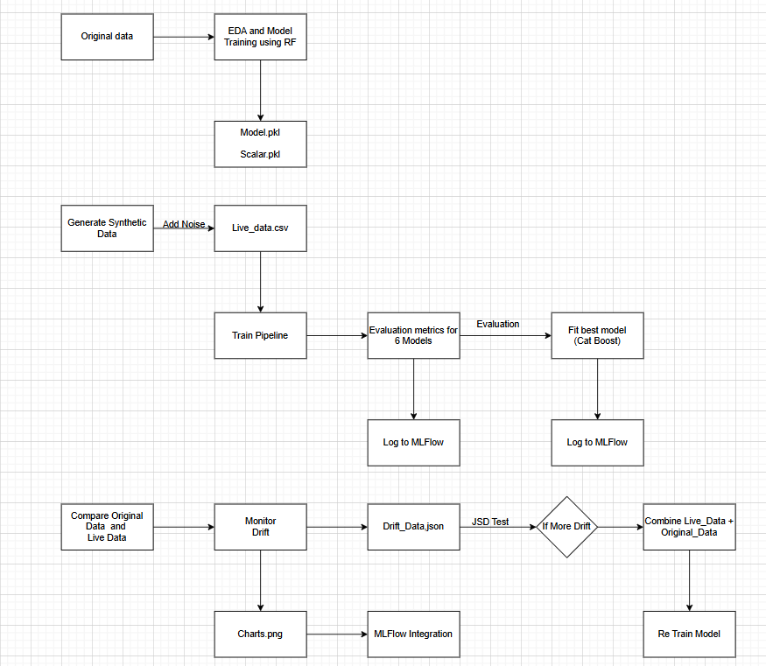

Slide 9
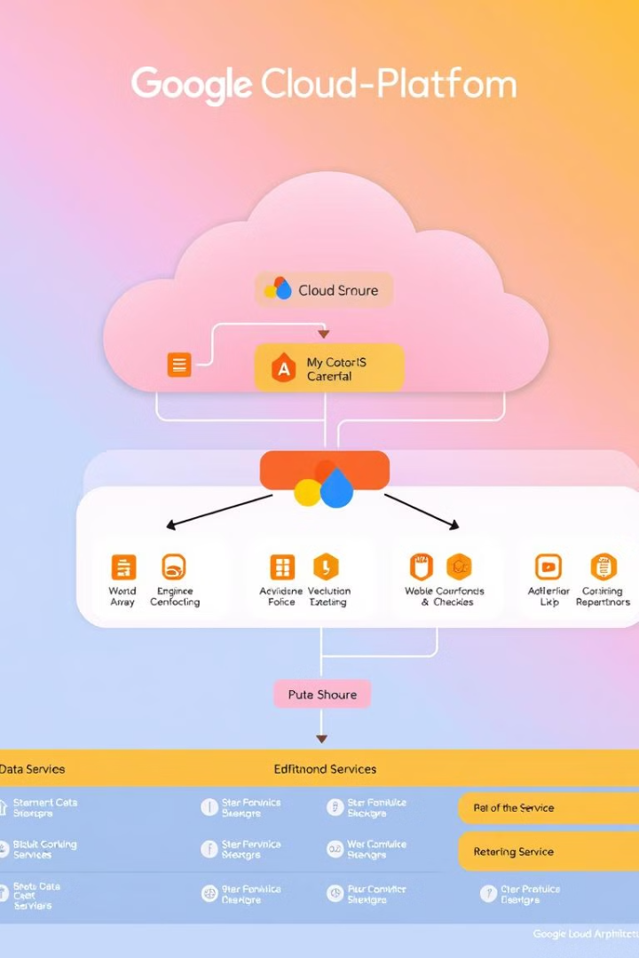



Leveraging Google Cloud Platform: A Powerful Ecosystem
Artifact Registry
Cloud Build
Stores Docker images for containerized applications.
Automates CI/CD deployment workflows for streamlined releases.
Cloud Run
Deploys FastAPI and Streamlit apps for scalable and reliable service.

Slide 10
Technical Stack: The Building Blocks of Success
Python
MLflow
GitHub
The primary programming language used for data processing, model training, and application development.
A powerful tool for managing machine learning experiments, tracking model performance, and deploying models.
A platform for version control and collaborative development, enabling seamless code sharing and updates.
Google Cloud Platform
Docker
FastAPI
A comprehensive cloud computing platform with services for data storage, machine learning, and application deployment.
A containerization technology for packaging applications and their dependencies, ensuring consistent execution across different environments.
A high-performance web framework for building APIs, enabling efficient integration with other systems.
Streamlit
A Python library for building interactive web applications, providing a user-friendly interface for visualizing data and predictions.

Slide 11
Thank you

